Slide 1
Ruby Calalo NP
Infectious Disease
Go Live: 09/01/2023
Last Updated: 09/12/2023

Slide 2
PRACTICE DETAILS
Specialty | Infectious Disease
Providers | Ruby Calalo is the only provider in the group. Drs. Schneider, Su and Hean are also set-up in this group as BILLING providers for SPLIT/SHARED VISITS.
CareTracker Company | ProHealth Partners
CareTracker Group | Calalo, Ruby NP
Superbill | HOSPITAL: Provider will be submitting their own version of a hospital round-sheet (see slide #5).
Medicare Fee Schedule | 150% (Area 18, Los Angeles County) Fee Schedule will change to 200%, effective 2024.
End of Month Closing | 3rd Business Day of New Month
Coding Training | 08/21/2023 at Argus Office (Jose/Imee)
EMR Utilized | Epic (Hospital EMR)
Turn-Around-Time (TAT) | 3 Days
Submission Method | Email (coding@argusmso.net) courtesy of Emily Matheson
eBridge Training | N/A

Slide 3
PRACTICE LOCATIONS
Location | CT Short Name | Place of Service | Types of Services
Lakewood Regional Medical Center Address: 3700 South St. Lakewood, CA 90712-1419 Phone: (562) 531-2550 | LRMC | Inpatient Hospital (21) On-Campus Outpatient Hospital (22) | Consultations Hospital Visits
Long Beach Memorial Medical Center Address: 2801 Atlantic Ave. Long Beach, CA 90806 Phone: (562) 933-8652 Fax: (562) 933-8016 | LBMMC | Inpatient Hospital (21) On-Campus Outpatient Hospital (22) | Consultations Hospital Visits
Los Alamitos Medical Center Address: 3751 Katella Ave. Los Alamitos, CA 90720-3101 Phone: (562) 598-1311 | LAMC | Inpatient Hospital (21) On-Campus Outpatient Hospital (22) | Consultations Hospital Visits
St. Mary Medical Center Address: 1050 Linden Ave. Long Beach, CA 90813-3321 Phone: (562) 491-9929 Fax: (562) 491-9085 | SMMC | Inpatient Hospital (21) On-Campus Outpatient Hospital (22) | Consultations Hospital Visits
Notes:
Inpatient Hospitals

Slide 4
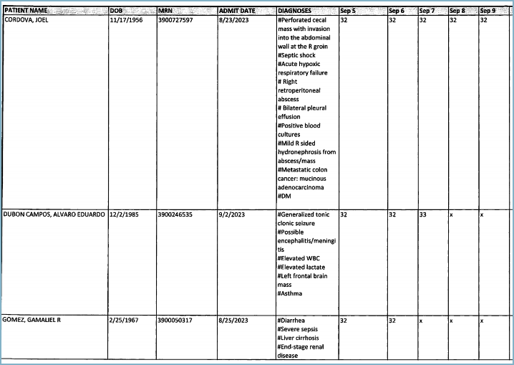
HOSPITAL SUPERBILL Provider-Created Round-sheet
Ruby Calalo is utilizing her own version of a hospital round-sheet to list out all her services within a given week.
She will be attaching a copy of each patient’s facesheet to the round-sheet, for demographic entry.
Notes:
Slide Finalized

Slide 5
RESPONSIBILITIES Argus DEMO Entry
TEAM RESPONSIBLE – MOHALI
Demo Entry | HOSPITAL CHARGES: Hospital demographics are to be entered by Argus.
Insurance Verification | HOSPITAL CHARGES: Insurance information must be verified by Argus.

Slide 6
RESPONSIBILITIES Argus CHARGE Entry
TEAM RESPONSIBLE – MOHALI
Charge Entry | HOSPITAL CHARGES: Team must enter charges directly into CareTracker.
Last Updated: 08/07/2023

Slide 7
RESPONSIBILITIES Argus CODING Team
TEAM RESPONSIBLE – NOIDA (Vishesh’s Cluster)
Coding Feedback | Any coding feedback should be sent to Jose/Rahul for review and communication to the providers.
Charges on Hold | Team to review and clear any pending Charges on Hold prior to EOM closing.
CM Edits | Team to review and clear any pending CM Edits prior to EOM closing.

Slide 8
RESPONSIBILITIES PROVIDER & STAFF
Charge Submission | HOSPITAL CHARGES: Emily Matheson will be submitting billing via email (coding@argusmso.net).
Rejections | All rejections are sent to Emily Matheson; she will forward to provider.

Slide 9
RESPONSIBILITIES Argus LIAISON & AVATAR
Rejections | Jose & Rahul to review rejections before sending to Emily.
Charges on Hold | Jose & Rahul to review pending Charges on Hold prior to EOM closing.
CM Edits | Jose & Rahul to review pending CM Edits prior to EOM closing.

Slide 10
INSURANCE BILLING GUIDELINES
Medicare | Charges can be billed as they are received.
Medi-Cal | Medi-Cal application is pending; charges should be placed on hold until approval is received.
HMOs | Charges can be billed as they are received.
PPOs | Charges can be billed as they are received.
Payer Mix
Medicare
Medi-Cal
PPO
HMO

Slide 11
CONTACT LIST
Team | Name & Information
Client | Emily Matheson (Office Staff) Email: e.matheson@drschneiderid.com Phone: (562) 684-2560
 | Ruby Calalo, NP (Provider) Email: rubcalalo@gmail.com Phone:
Argus (Corporate) | Carol Creighton (Accounts Receivable)
 | Jose Ortiz (Coding & Charge Entry)
 | Jennifer Rubio (Credentialing)
 | Janett Benites (Payments & Treasury)
 | Patty Durna (Regional Manager)

